Slide 1


Slide 2













CIPHER WEB - A TOOL FOR YOUR PRIVACY

Slide 3
Your Gateway to Secure Cryptography.
With a suite of powerful encryption tools and seamless integration with Firebase services, CipherWeb ensures robust data protection and privacy in today's digital landscape.
Explore the world of cryptography and unlock the potential of CipherWeb for secure communication and data security.

Slide 4
OBJECTIVES
Provide users with a secure platform for encryption and decryption.
Offer a diverse range of cryptographic algorithms for data protection.

Slide 5
Facilitate seamless integration with Firebase backend services.
Ensure user-friendly interfaces for easy navigation and usage.
Enable users to manage profiles, access encryption history, and upload profile pictures securely.
Promote digital privacy and data security in online interactions.

Slide 6
FEATURES
- Encryption and Decryption: Securely encrypt and decrypt messages using a variety of cryptographic algorithms, including Blowfish, RSA, and Vigenère cipher.
- Firebase Integration: Seamlessly integrate with Firebase backend services for user authentication, database management, and cloud storage.
- User Authentication: Implement Firebase Authentication to ensure secure user login and authentication.
- User Dashboard: Provide authenticated users with a personalized dashboard to access features such as encryption history, profile management, and more.
- Profile Picture Upload: Allow users to upload and manage profile pictures securely using Firebase Cloud Storage.
- Encryption History: Enable authenticated users to view and manage their encryption history, including timestamps and algorithms used.
- User-friendly Interface: Offer an intuitive and easy-to-use interface for seamless navigation and interaction with cryptographic functionalities.
- Digital Privacy: Promote digital privacy and data security by providing robust encryption tools and secure user management features.

Slide 7





Technology Stack
Frontend:
Framework: Tailwind CSS
Language: JavaScript
Framework/Library: JavaScript Canvas
Backend:
Platform: Firebase
Services:
Firebase Authentication
Firebase Realtime Database
Firebase Cloud Storage

Slide 8
CIPHER WEB - A Brief Demonstration Of The Website.

Slide 9
Explore Our Collection of Cryptographic Algorithms
Understanding the basics of cryptography

Slide 10
Understanding The Basics Of Cryptography
Cryptography Fundamentals:
Encryption and Decryption:
Cryptographic Algorithms:
Cryptography forms the cornerstone of digital security, utilizing mathematical algorithms to encode data, ensuring confidentiality, integrity, and authenticity.
Cryptography involves the processes of encryption and decryption. Encryption transforms plaintext data into ciphertext using an algorithm and a secret key, while decryption reverses this process to recover the original plaintext.
Various cryptographic algorithms, such as AES, RSA, and SHA, are utilized to encrypt and decrypt data. These algorithms play a vital role in securing information and communications across digital platforms.

Slide 11
Key Management:
Cryptographic Protocols:
Keys are essential components in cryptography, controlling the encryption and decryption processes. Secure key management practices are crucial to maintaining data security and preventing unauthorized access.
Cryptographic protocols define rules and procedures for secure communication and interaction between parties. These protocols establish secure channels for data transmission and ensure the integrity and authenticity of exchanged information.

Slide 12

Evolution of Cryptography
Tracing the Remarkable Journey of Cryptography
Historical Development
Critical Role
Cryptography has evolved from simple substitution ciphers to complex mathematical algorithms, shaping the course of secure communication.
It has played a crucial role in wartime communication, financial transactions, and modern digital security, influencing pivotal aspects of human history and progress.
Technological Advancement
Digital Landscape
The evolution of cryptography reflects the advancement of technology, from classic ciphers to modern encryption techniques, safeguarding digital assets and securing sensitive information.
Cryptography has become indispensable in the digital landscape, ensuring the secure operation of organizations, financial institutions, and critical infrastructure.

Slide 13


Services Provided By CipherWeb
02
01
GRONSFELD
BLOWFISH
A variant of the Vigenère cipher, employing a keyword to shift plaintext characters, providing moderate security and ease of implementation.
A fast symmetric-key block cipher with variable key lengths, widely used for its efficiency and simplicity in encryption and decryption.

Slide 14
03
02
01
HUFFMAN
GRONSFELD
BLOWFISH
A data compression algorithm utilizing variable-length codes to represent characters by assigning shorter codes to more frequent characters.
A variant of the Vigenère cipher, employing a keyword to shift plaintext characters, providing moderate security and ease of implementation.
A fast symmetric-key block cipher with variable key lengths, widely used for its efficiency and simplicity in encryption and decryption.

Slide 15
04
03
02
01
MORSE
HUFFMAN
GRONSFELD
BLOWFISH
A method of encoding text characters as sequences of dots and dashes, commonly used in telecommunication for transmitting textual information.
A data compression algorithm utilizing variable-length codes to represent characters by assigning shorter codes to more frequent characters.
A variant of the Vigenère cipher, employing a keyword to shift plaintext characters, providing moderate security and ease of implementation.
A fast symmetric-key block cipher with variable key lengths, widely used for its efficiency and simplicity in encryption and decryption.

Slide 16
05
04
03
02
01
POLYBIUS
MORSE
HUFFMAN
GRONSFELD
BLOWFISH
A cryptographic technique fractionating plaintext characters into pairs of numerical values, facilitating encryption & decryption through substitution & transposition.
A method of encoding text characters as sequences of dots and dashes, commonly used in telecommunication for transmitting textual information.
A data compression algorithm utilizing variable-length codes to represent characters by assigning shorter codes to more frequent characters.
A variant of the Vigenère cipher, employing a keyword to shift plaintext characters, providing moderate security and ease of implementation.
A fast symmetric-key block cipher with variable key lengths, widely used for its efficiency and simplicity in encryption and decryption.

Slide 17
06
05
04
03
02
RSA
POLYBIUS
MORSE
HUFFMAN
GRONSFELD
A public-key encryption algorithm leveraging the mathematical properties of large prime numbers to generate secure key pairs.
A cryptographic technique fractionating plaintext characters into pairs of numerical values, facilitating encryption & decryption through substitution & transposition.
A method of encoding text characters as sequences of dots and dashes, commonly used in telecommunication for transmitting textual information.
A data compression algorithm utilizing variable-length codes to represent characters by assigning shorter codes to more frequent characters.
A variant of the Vigenère cipher, employing a keyword to shift plaintext characters, providing moderate security and ease of implementation.

Slide 18
07
06
05
04
03
CAESAR
RSA
POLYBIUS
MORSE
HUFFMAN
A simple substitution cipher involving shifting each letter in the plaintext by a fixed number of positions in the alphabet, operating on the principle of substitution with a fixed key.
A public-key encryption algorithm leveraging the mathematical properties of large prime numbers to generate secure key pairs.
A cryptographic technique fractionating plaintext characters into pairs of numerical values, facilitating encryption & decryption through substitution & transposition.
A method of encoding text characters as sequences of dots and dashes, commonly used in telecommunication for transmitting textual information.
A data compression algorithm utilizing variable-length codes to represent characters by assigning shorter codes to more frequent characters.

Slide 19
08
07
06
05
04
RAIL FENCE
CAESAR
RSA
POLYBIUS
MORSE
A transposition cipher rearranging plaintext characters in a zigzag pattern along a specified number of "rails," facilitating encryption and decryption by writing and reading off the ciphertext row by row.
A simple substitution cipher involving shifting each letter in the plaintext by a fixed number of positions in the alphabet, operating on the principle of substitution with a fixed key.
A public-key encryption algorithm leveraging the mathematical properties of large prime numbers to generate secure key pairs.
A cryptographic technique fractionating plaintext characters into pairs of numerical values, facilitating encryption & decryption through substitution & transposition.
A method of encoding text characters as sequences of dots and dashes, commonly used in telecommunication for transmitting textual information.

Slide 20
09
08
07
06
05
VERNAM
RAIL FENCE
CAESAR
RSA
POLYBIUS
Also known as the one-time pad, a symmetric-key encryption algorithm using a random key of the same length as the plaintext, achieving perfect secrecy when the key is truly random and used only once.
A transposition cipher rearranging plaintext characters in a zigzag pattern along a specified number of "rails," facilitating encryption and decryption by writing and reading off the ciphertext row by row.
A simple substitution cipher involving shifting each letter in the plaintext by a fixed number of positions in the alphabet, operating on the principle of substitution with a fixed key.
A public-key encryption algorithm leveraging the mathematical properties of large prime numbers to generate secure key pairs.
A cryptographic technique fractionating plaintext characters into pairs of numerical values, facilitating encryption & decryption through substitution & transposition.

Slide 21
10
09
08
07
06
VIGENERE
VERNAM
RAIL FENCE
CAESAR
RSA
A polyalphabetic substitution cipher encrypting plaintext using a keyword or passphrase, employing multiple Caesar ciphers based on the letters of the keyword, providing enhanced encryption compared to simple substitution techniques.
Also known as the one-time pad, a symmetric-key encryption algorithm using a random key of the same length as the plaintext, achieving perfect secrecy when the key is truly random and used only once.
A transposition cipher rearranging plaintext characters in a zigzag pattern along a specified number of "rails," facilitating encryption and decryption by writing and reading off the ciphertext row by row.
A simple substitution cipher involving shifting each letter in the plaintext by a fixed number of positions in the alphabet, operating on the principle of substitution with a fixed key.
A public-key encryption algorithm leveraging the mathematical properties of large prime numbers to generate secure key pairs.

Slide 22
10
09
08
07
VIGENERE
VERNAM
RAIL FENCE
CAESAR
A polyalphabetic substitution cipher encrypting plaintext using a keyword or passphrase, employing multiple Caesar ciphers based on the letters of the keyword, providing enhanced encryption compared to simple substitution techniques.
Also known as the one-time pad, a symmetric-key encryption algorithm using a random key of the same length as the plaintext, achieving perfect secrecy when the key is truly random and used only once.
A transposition cipher rearranging plaintext characters in a zigzag pattern along a specified number of "rails," facilitating encryption and decryption by writing and reading off the ciphertext row by row.
A simple substitution cipher involving shifting each letter in the plaintext by a fixed number of positions in the alphabet, operating on the principle of substitution with a fixed key.

Slide 23



THE PROBLEM
Inadequate Data Protection: A Threat to Personal Privacy and Business Security
Inadequate data protection exposes individuals and businesses to cybersecurity threats, leading to data breaches, financial losses, and compromised personal information.

Slide 24


Slide 25
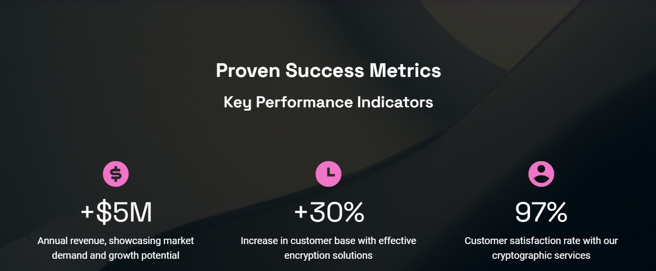

Slide 26
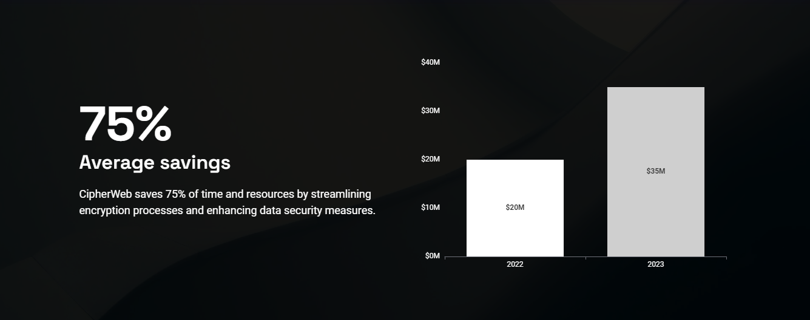

Slide 27
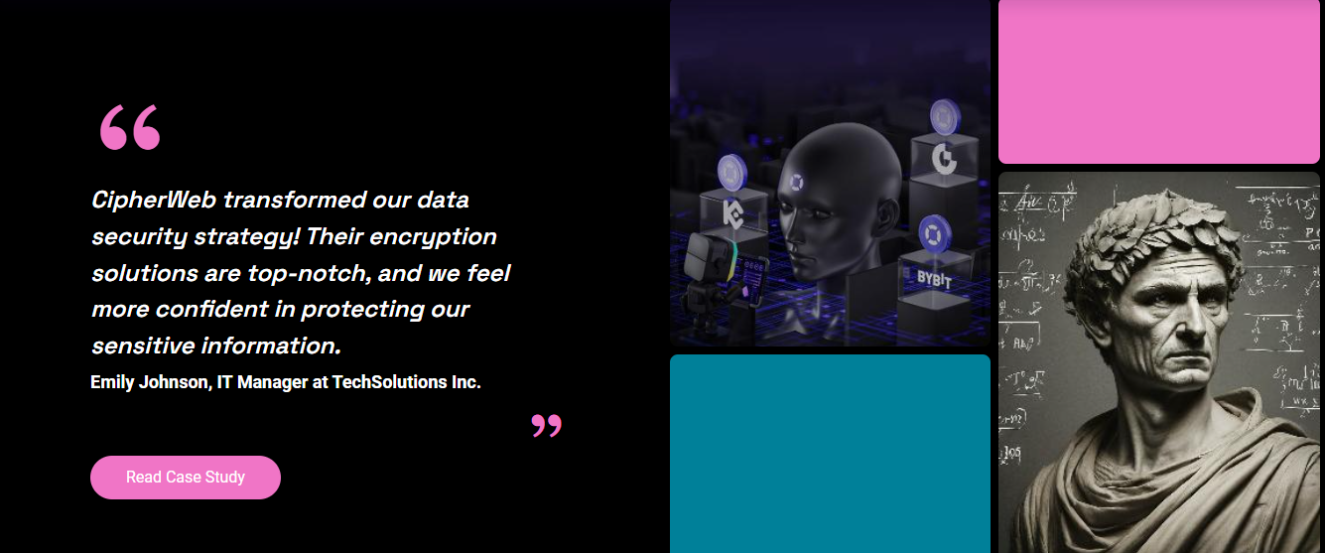

Slide 28


Slide 29


Slide 30

CONCLUSION
CipherWeb offers a secure and user-friendly solution for encryption and decryption needs. With its integration with Firebase backend services and a variety of cryptographic algorithms, it provides robust data protection and privacy. The platform's intuitive interface and features like user authentication, profile management, and encryption history make it a reliable choice for safeguarding digital information.

Slide 31
Empowering Digital Security
Unlock the Power of Cryptography with CipherWeb
By - Kalam Pinjar BCA CYBER

